Slide 1
Erasmus+ Capacity Building projects
in the field of Higher Education
Call 2018
FINANCIAL MANAGEMENT OF THE GRANT
  Grant Holders' Meeting
Brussels, 28-29 January 2019

Slide 2

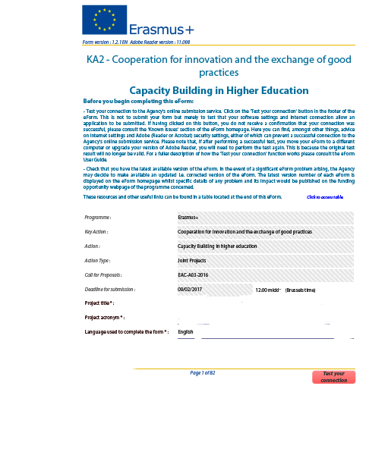

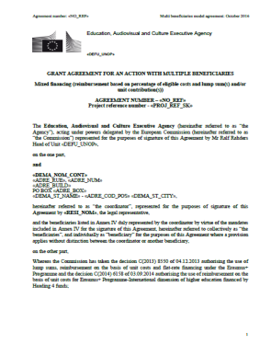
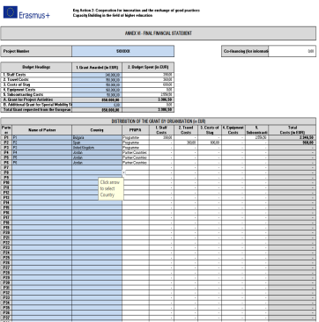
Regulatory Framework
EACEA Documents Application Your documents
National legislation
&
Institutional regulation
Any prior authorisation from EACEA

Slide 3
  OUTLINE
  1) Financing principles
  2) Actual costs
  3) Unit costs
  4) Management of the Grant and amendments
  5) Financial reporting
  6) Final grant
  7) Checks & Audits
  NB: Please note that this document has no legal value

Slide 4
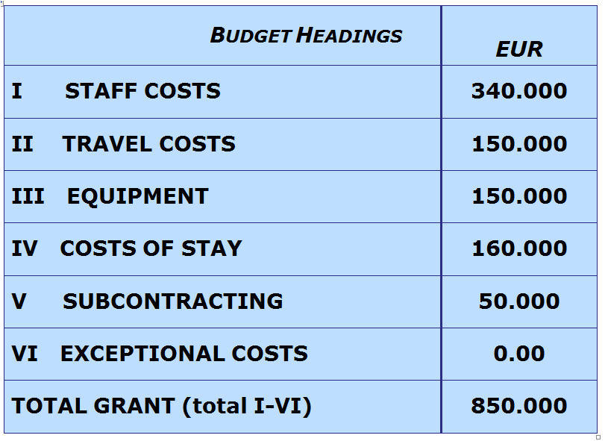
  BUDGET MODEL
  (Annex III of Grant Agreement)

Slide 5
  1) Financing principles
  Funding rule & Financing approach
  Budget headings and ceilings
  Eligible / Ineligible costs

Slide 6
Funding rule & Financing approach
Co-funding principle
Grant ≠ Total costs of the project
Grant
(combination of two different financing approaches)
AC: Actual costs (Equipment, Subcontracting and Exceptional costs)
UC: Unit Costs (Staff, Travel and Costs of stay)

Slide 7
  Budget headings and ceilings

Slide 8
Eligible Costs
Article II.19.1 Grant Agreement
  Incurred by the beneficiaries during the eligibility period
  Foreseen in the application/budget
  In connection with action/necessary for project implementation
  Identifiable, verifiable, recorded in the accounting records
  Comply with requirements of tax/national legislation
  Reasonable, complying with sound financial management (economy and efficiency)

Slide 9
Ineligible Costs
1) Costs NOT fulfilling requirements of Art. II.19.1
2) Art. I.10.4/II.19.4
examples:
equipment such as: furniture, motor vehicles, alarm systems
costs linked to the purchase of real estate
activities not in project beneficiaries' countries (Annex IV), unless prior authorisation
Exchange losses
in kind contribution
excessive expenditure
deductible VAT

Slide 10
Affiliated Entities of a Beneficiary
  Organisations that have a legal or capital link with a beneficiary and that contribute to the achievement of project objectives and activities under the responsibility of the beneficiary concerned.
  Must be identified in the Grant Agreement in order to have their costs reported under the project budget
  Example: Organisation X, with headquarters in Madrid, is part of a network of 20 institutions. Staff members from one of the network institutions may work for the project and claim eligible costs as long as this institution is included as an affiliated entity in the G.A.

Slide 11
  2) Actual costs
  Definition
  VAT
  Exchange rate
  Tendering procedure
  Equipment
  Subcontracting
  Exceptional (travel) costs
  (described under the "unit costs" section)

Slide 12
Actual costs - Definition
Expenses actually incurred
(Documented and justified with corresponding level of cost)
Example:
Reported cost (laptops) of 1.500 EUR
=
Supporting documents to the value of 1.500 EUR

Slide 13
VAT
(Art. II.19.4 GA)
Ineligible
Unless
official document from competent authorities proving that the corresponding costs cannot be recovered
Check with NEO/EU Delegation
if an agreement exists between EU and Partner Country

Slide 14
Exchange rate (Art. I.10.2 GA)
2
Which exchange rate should be applied?
Rate to apply:
http://ec.europa.eu/budget/contracts_grants/info_contracts/inforeuro/index_en.cfm
EXAMPLE
1st Pre-financing: 23 Dec 2018 – 2nd Pre-financing: 22 Aug 2019
Invoice date: 09 January 2019 Applicable monthly rate: December 2018
All transactions must be declared in EUR in the Final Report
1) From start of eligibility period until receipt of second pre-financing:
monthly rate of reception of FIRST PRE-FINANCING
2) From date of receipt of second pre-financing until end of eligibility period: monthly rate of reception of SECOND PRE-FINANCING

Slide 15



Procurement of goods/services
Less than 25.000 €
Best value for money
25.000 € - 134.000 €
Tendering procedure
More than 134.000 €
National Legislation

Slide 16


Equipment
Relevant to the objectives of the project
and foreseen in the application
Total purchase cost (no depreciation)
Exclusively for Partner Country Higher Education Institutions
Recorded in the inventory of the institution
Labelled with E+ stickers (to be printed by beneficiaries)
https://eacea.ec.europa.eu/about-eacea/visual-identity-and-logos-eacea/erasmus-visual-identity-and-logos_en
Purchased and installed as soon as possible in order to be used during project implementation
Equipment not foreseen in the application? Prior authorisation (Serious) Delays in the purchase/instalment? From the Agency !

Slide 17


Subcontracting
Implementation of specific tasks, by third party, to which a contract is awarded by one/several beneficiaries
Examples:
  Evaluation activities/auditing
  IT courses, Language courses
  Printing, publishing and dissemination activities
  Translation services
  Web design and maintenance
Not foreseen in the application? Prior authorisation from Agency
Tasks that cannot be performed by Beneficiaries
NO project-management related tasks

Slide 18
Supporting documents
Equipment
Invoice(s) and proofs of payment
Subcontracting
Invoice(s), subcontracts and proofs of payment
> EUR 25.000 < EUR 134.000: tendering procedure and three quotations from different suppliers
EUR 134.000: procedure according to national legislation
Registration in the inventory
> EUR 25.000 < EUR 134.000: tendering procedure and three quotations from different suppliers
EUR 134.000: procedure according to national legislation
Travel activities of subcontracted service provider: copies of travel tickets, boarding passes, invoices and receipts
To keep with project accounts
To send with Final Financial statement:
>EUR 25.000: invoices, (subcontracts for subcontracting), competitive offers
Any prior authorisation from the Agency

Slide 19
3) Unit costs
  Definition
  Staff costs
  Travel costs and costs of stay

Slide 20
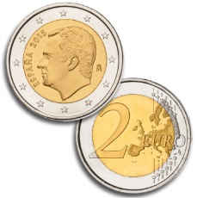

Unit cost - Definition
  No need to justify level of spending
  Financial control/audit declared unit costs supported with proofs of activities implemented
  Fixed contribution multiplied by number of units,
  based on "Triggering events" (activities/outputs)

Slide 21

Partnership Agreement
Grant management cycle | UNIT COST | ACTUAL COSTS
Grant allocation | Based on estimated work programme | Based on the estimated budget
Grant Implementation | Beneficiary's own FINANCIAL "RECIPE" | Record costs actually incurred
Justification of the Grant | Based on activities actually implemented | Based on costs actually incurred

Slide 22
Staff Costs
Unit cost = amount in Euro per working day per staff (not linked to the actual level of remuneration in the salary slip)
Calculation 3 variables: staff category, country, number of days
a) Categories: Managers, Researchers/Teachers/Trainers, Technical, Administrative nature of work performed, not status of individual
b) Country in which staff is employed, independently of where tasks are executed
c) Number of days proportioned to the work carried out
*Formal contractual relationship with a beneficiary organisation
  Contribution to Institutions for Staff* performing tasks necessary to achieve the objectives of the project

Slide 23
Staff Costs
Example
A staff employed in Lithuania performing teaching activity for 3 days:
222 Euro (3 unit costs of 74 Euro each)
One working day according to national legislation (7 to 8 hours)
In principle max. 20 days/month or 240 days/year

Slide 24
Supporting documents
To keep with project accounts:
Staff Costs
Joint Declaration (EACEA template)
Time-sheets (EACEA template)
Proof of formal contractual relationship
Evidence justifying workload and activities/outputs (e.g. attendance lists , tangible outputs / products)
To send with Final Financial statement:
Any prior authorisation from the Agency

Slide 25
Travel costs and Costs of Stay
  Calculation: 3 variables travel distance (travel costs), duration (costs of stay) and type of participant
Staff
  Under contract with beneficiary
  Travels intended for the activities listed in the E+ Programme Guide
  Duration: Max. 3 months
  Students
  Registered under beneficiary institutions
  Duration: Min. 2 weeks – Max. 3 months (Max. 1 week for short term activities linked to the management of the project)
  Eligible activities Erasmus+ Programme Guide (CBHE section)
Travel/stay for staff/students participating in eligible activities related to the achievement of the project

Slide 26

Travel costs: rules
  Travel distance calculator (one-way travel):
  http://ec.europa.eu/programmes/erasmus-plus/tools/distance_en.htm
  Calculation unit cost corresponding to applicable distance band
  7 distance bands (see Erasmus+ Programme Guide - CBHE section)
From home institution to venue of activity
(project beneficiaries' countries) and return

Slide 27
Travel costs: rules examples
  Case 1
  Participant from Madrid (ES) takes part in activity in Rome (IT)
  Madrid - Rome (1365 Km): unit cost (distance band 500/1999 Km): 275 €
  Case 2
  Participant from Madrid takes part in activities first in Rome and then in Kiev (circular travel)*
  Madrid - Rome (1365 Km): unit cost (distance band 500/1999 Km): 275 €
  +
Rome – Kiev (1680 Km): unit cost (distance band 500/1999 Km): 275 €
= 550€

Slide 28
exceptional costs
(financed under actual costs)
Expensive travel costs of participants
  If for a specific travel, the UC contribution represents less than 65% of the actual/real travel costs, financial support under the budget heading "exceptional costs" can be claimed. This financial support is limited to a maximum of 80% of the actual/real costs
Example:
13-17 Feb 2019 Almaty (Kz) – Plovdiv (BG)
Distance in km (distance calculator) 4.197
Cost of flight: 1.321€
Unit cost: 820€ (less than 65% of actual cost of flight, which is 858,65€)
Exceptional cost (replacing unit cost) 1.056,80€ (= 80% of the actual cost of flight)
As all other budget headings, "Exceptional costs" can be increased without amendment by up to 10% as compared to the amount mentioned in the G.A. Any other circumstances (including where no Exceptional costs have been foreseen) will require an amendment

Slide 29
Travel costs in the "unit costs" system
4 meetings, 25 participants each, destination 2500 km =360 €
 | EACEA Unit costs | Real costs | Methodology applied within consortium | Balance (UC-RC)
Travel 1 | 360 | 210 | ?
Travel 2 | 360 | 420 | ?
Travel 3 | 360 | 700 | ?
… | … | … | …
Travel 100 | 360 | 290 | ?
scenario 1 TOTAL | 36.000 | 37.000 |  | -1.000
scenario 2 TOTAL | 36.000 | 35.000 |  | +1.000

Slide 30

Costs of stay: specific rules
Calculation:
number of days of activities (including travel) = Number of unit costs
Unit costs for staff unit costs for students
Staff: up to 14th day/between 15th and 60th day/between 61st day and up to 3 months
  Staff/students activities outside city of their home institution
Staff | 120 € | 70 € | 50 €
DAYS | Up to 14th day | 15th – 60th | 61st – 3 months
 |  | 15th – 90th
Students | 55 € | 40 €

Slide 31

Cost of stay: specific rules examples
A staff (Paris): activity in Brussels during 2 days (inc. travel)
Max. 2 unit costs of 120 € (TOTAL: 240 €)
A staff (Paris): activity in Brussels during 20 days (inc. travel)
Max. 14 unit costs of 120 € + 6 unit costs of 70 € (TOTAL: 2.100 €)
A student (Paris): activity in Berlin during 22 days (inc. travel)
Max. 14 unit costs of 55 € + 8 unit costs of 40 € (TOTAL: 1.090 €)

Slide 32
Supporting documents
Travel and Costs of Stay
(e.g. travel tickets, boarding passes, invoices, receipts, proof of attendance in meetings, agendas, tangible outputs/products, minutes)*
Individual Travel Report (EACEA templates) + Supporting documents
*Non-exhaustive list
Exceptional costs
Proof of the actual cost of the travel
To send with Final Financial statement:
Any prior authorisation from the Agency

Slide 33
  4) Management of the Grant and amendments
5) Financial Reporting
6) Calculation of the Final Grant
7) Checks & Audits(Art. II.27)

Slide 34
  4) Management of the Grant and amendments
    Grant paid on the bank account of the coordinator (Art I.5 of GA)
Methods for distributing the grant/reimbursing the costs between coordinator and partners Detailed in Partnership Agreement:
    decision on HOW to reimburse costs (in particular UC)
    decision on WHERE to pay (/to whom)
    c) decision on WHEN to pay
    No ideal / unique / imposed method >>> specific situation of each partner should be taken into account
    Transfers amongst project beneficiaries >>> only to institutional bank accounts

Slide 35

Art. II.12 of Grant Agreement
No later than one month before the end of the project!

Slide 36
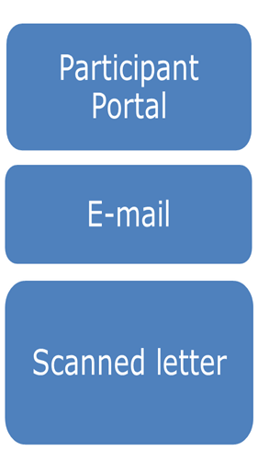
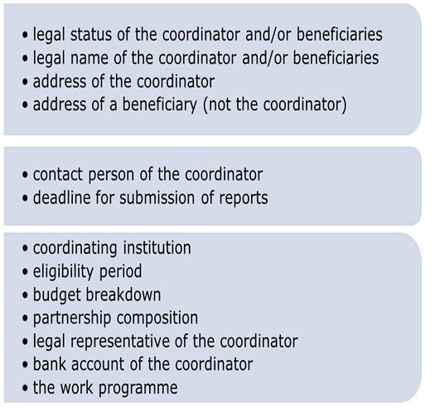
Request change of Done through…….

Slide 37
Before Asking for an Amendment
Principle: the application is the baseline for project implementation
Estimate the impact of the proposed change on the project:
  Compare this change/deviation with the initial work plan
  Make sure it stays within the scope of the project and complies with the programme's rules
  Who does it affect – one partner/the whole partnership?
  Does it have an effect on the project budget?
  Does it have an effect on the project timeframe?
  Any risk that the project will not deliver the planned outputs?
  Reflect on alternative solutions (fall-back plan)

Slide 38
Budget Transfers
(between budget headings)
Increase
UP to 10%
Even above the ceilings (for staff, equipment and subcontracting)
No prior authorization
Increase by MORE than 10%
  Amendment
    Ceilings cannot be exceeded
Staff costs | % of total grant in G.A. | Proposed increase | Effect on % of total grant | Decision
Max ceiling: 40% | 30% | +20% | 36% | Amendment possible
 | 35% | +20% | 42% | Not allowed

Slide 39
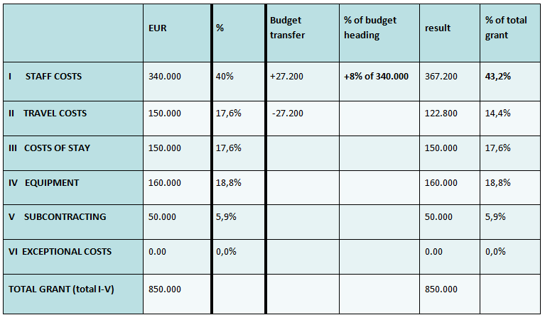
Budget Transfers
Example 1 = NO need for amendment

Slide 40
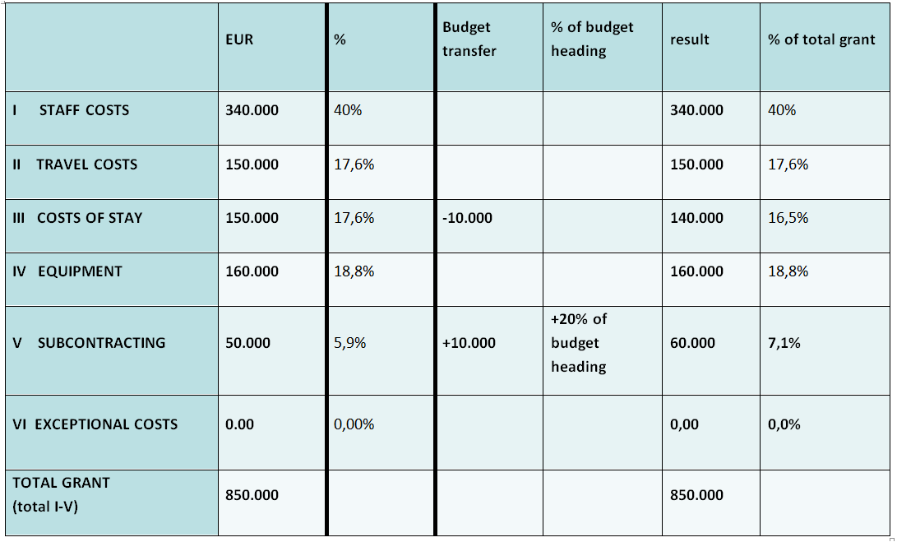
Budget Transfers
Example 2 – amendment

Slide 41
5) Financial Monitoring and Reporting
  Financial monitoring per budget heading/partner/WP during project implementation (for budget consumption)
  Statement on the use of the previous pre-financing for PR and request for second pre-financing
  Financial reporting at final report stage, supported by Audit Certificate (Report of Factual Findings on the Final Financial Report - Type II)
  Financial Statements (".xls" format) available at:
  https://eacea.ec.europa.eu/erasmus-plus/beneficiaries-space_en
  Financial statements (Excel) main financial reporting tool:

Slide 42
  6) Calculation of the Final Grant
  Grant will never exceed maximum amount indicated in Grant Agreement
  FINAL GRANT
  Examination of: a. financial statements
  b. eligibility of activities implemented
  c. eligibility of declared expenses
  2) Examination of potential penalties applied on maximum Grant
  FINAL GRANT = LOWEST VALUE between maximum Grant reduced by penalty(ies) and result of examination 1
  FINAL GRANT MINUS PRE-FINANCINGS
Positive value: balance payment
Negative value: recovery

Slide 43
A
Max. Grant (Anx III of GA): 850,000 €
B
Declared grant spent (in FR): 700,000 €
C
Eligible grant (after EACEA grant/activities analysis): 650,000 €
HOW WILL THE FINAL GRANT AMOUNT
BE DETERMINED?
Penalties ?
(for poor performance or non-respect of visibility obligations)
FINAL GRANT
Eligible grant = 650,000 €
NO
Max grant reduced by penalty = 637,500 €
YES for "Poor performance"
(Minus 25% of Max Grant = 637,500 €)
Eligible grant = 650,000 €
YES for "Visibility obligations"
(Minus 20% of Max Grant = 680,000 €)

Slide 44
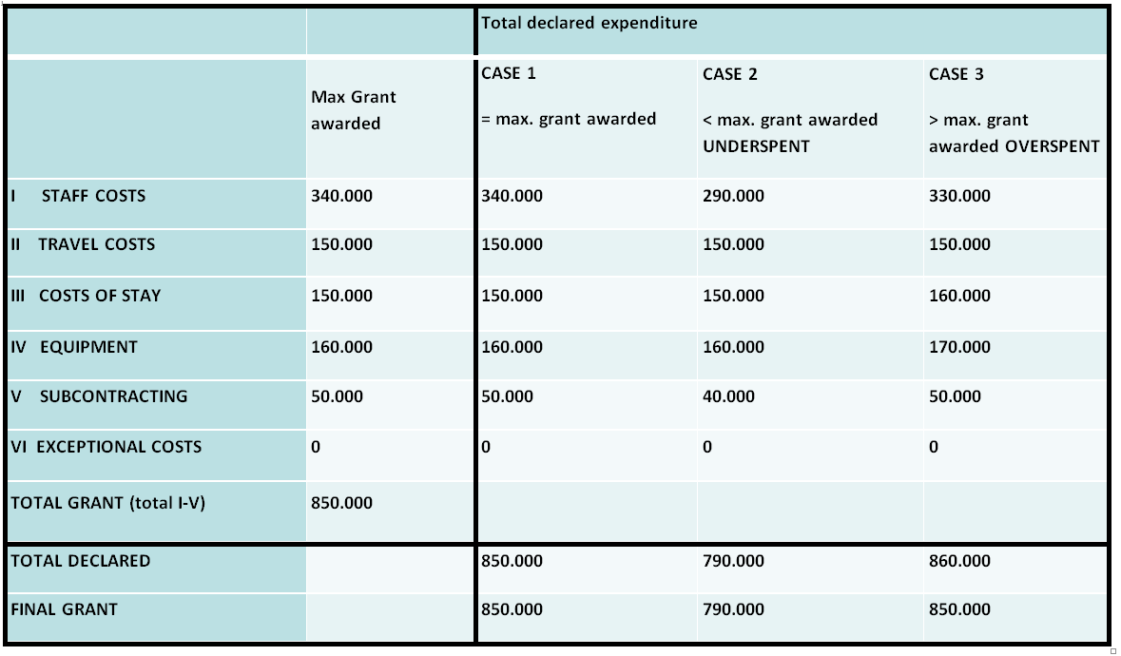
examples (1 of 2)

Slide 45
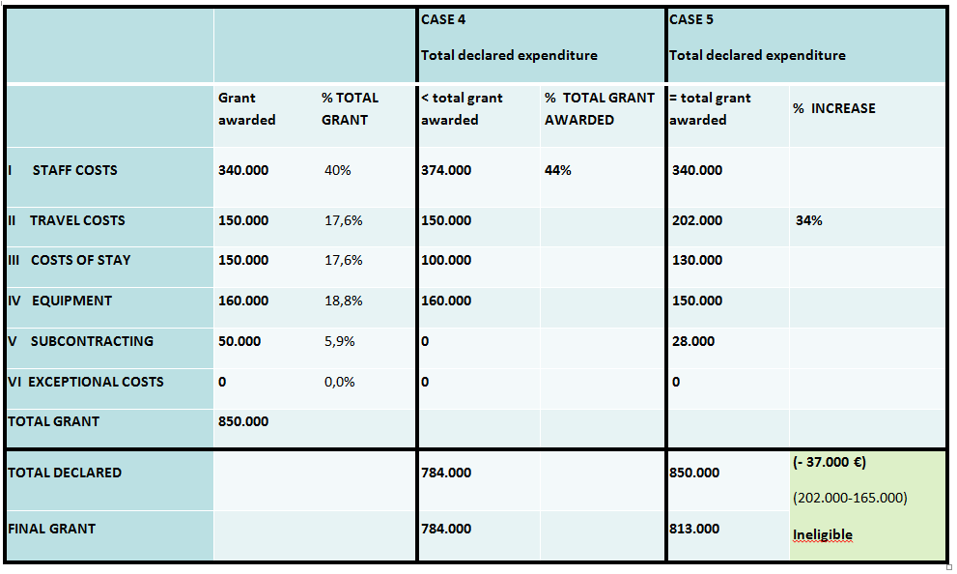
examples (2 of 2)

Slide 46
  7) Checks & Audits (Art. II.27)
EACEA/Commission may carry out technical/financial checks and audits in relation to the use of the grant
During implementation of Agreement and for a period of 5 years starting from the date of payment of the balance/recovery order
Usually outsourced to external auditors
At premises of coordinator and/or partners

Slide 47

  Final messages
Transparency/Partnership Agreement
Regular monitoring/reporting
Minimum 60% of Unit costs a lot of flexibility consider the specific needs/means of your partners
In case of doubts…ASK!

